Slide 1
Cluster Analysis: Basic Concepts and Methods
Cam Tu Nguyen
阮锦绣
Software Institute, Nanjing University
nguyenct@lamda.nju.edu.cn
ncamtu@gmail.com

Slide 2
Outline
Cluster Analysis
Partition Methods
Hierarchical Methods
Density-based Methods
Evaluation of Clustering

Slide 3
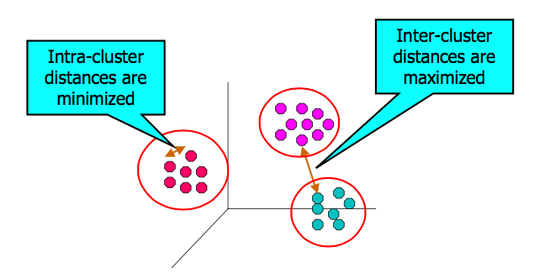
What is Cluster Analysis
Finding groups of objects such that the objects in a group will be similar (or related) to one another and different from (or unrelated to) the objects in other groups.

Slide 4
Applications of Cluster Analysis
Data reduction
Summarization: Preprocessing for regression, PCA, classification…
Compression: Image processing (vector quantization)
Prediction based on groups
Marketing: Help marketers discover distinct groups in their customer bases, and then use the knowledge to develop targeted marketing strategies.
Earth-quake studies: observed earth quake epicenters should be clustered along continent faults.
Finding K-nearest neighbors
Localizing search to one or a small number of clusters
Outlier Detection:
Outliers are often viewed as those “far away” from any cluster.

Slide 5
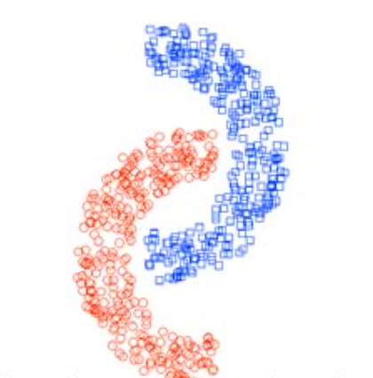
Requirements for Cluster Analysis
Scalability: able to scale to large data set.
Ability to deal with different types of attributes: able to work with numeric, binary, nominal, ordinal or mixture of these data types.
Discovery of clusters with arbitrary shape.

Slide 6
Requirements for Cluster Analysis
Requirements for domain knowledge to determine input parameters
The less requirement of domain knowledge, the better.
Able to deal with noisy data
Real-world data contains missing, unknown, or erroneous data. We need clustering algorithms that are robust to noise.
Incremental clustering and insensitivity to input order
When new data comes, we are able to update the “clusters” without rebuilding from scratch.
Constraint-based clustering
Interpretability and Usability

Slide 7
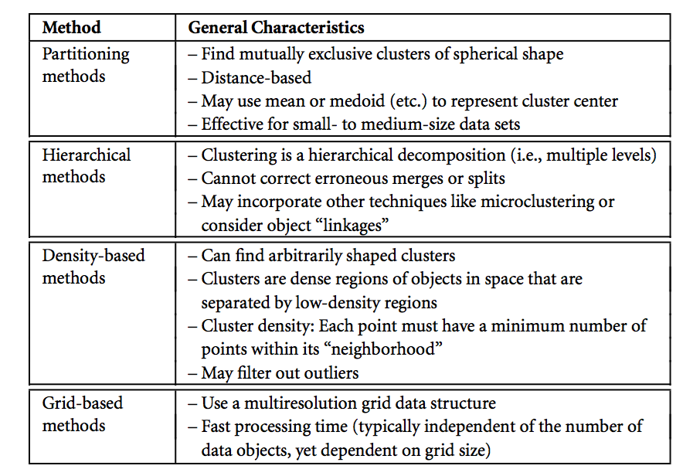
Overview of Basic Clustering Methods

Slide 8
Outline
Cluster Analysis
Partition Methods
Hierarchical Methods
Density-based Methods
Evaluation of Clustering

Slide 9
Partition Methods
The simplest and most fundamental version of cluster analysis
Organize objects into exclusive clusters
The number of clusters are often given as background knowledge
Examples:
K-means
K-medoids

Slide 10
Partition Methods
Problem:
Given a data set D of n objects in Euclidean space, and the number of clusters k
Partition the objects in D into k clusters:
K-means and K-medoids exploit the concept of centroids
Use centroid to represent a cluster.
Centroid = the center point of a cluster.
Can be defined by mean (k-means) or medoid (k-medoids) of points inside a cluster.

Slide 11
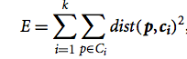
K-means
The objective: find k-clusters that minimizes the within-cluster variation
Each point is assigned to the nearest cluster (the cluster with the nearest centroid).
c_{i} is the centroid of the ith cluster, p is point in the cluster c_{i}, and dist(p, c_{i}) is the Euclidean distance between p and c_{i}
This problem is NP-hard.
K-means use a greedy algorithm
Often find local minimum.

Slide 12
K-means algorithm
Select K initial centroids
For each data point, assign it to the cluster with nearest centroid.
Update the centroids by calculating the means of the clusters based on the current point assignments.
Repeat 2) and 3) until convergence (the centroids do not move much)
Complexity is O(n*k*l*d), where n is the number of points, l is the number of iterations, and d is the number of attributes.

Slide 13
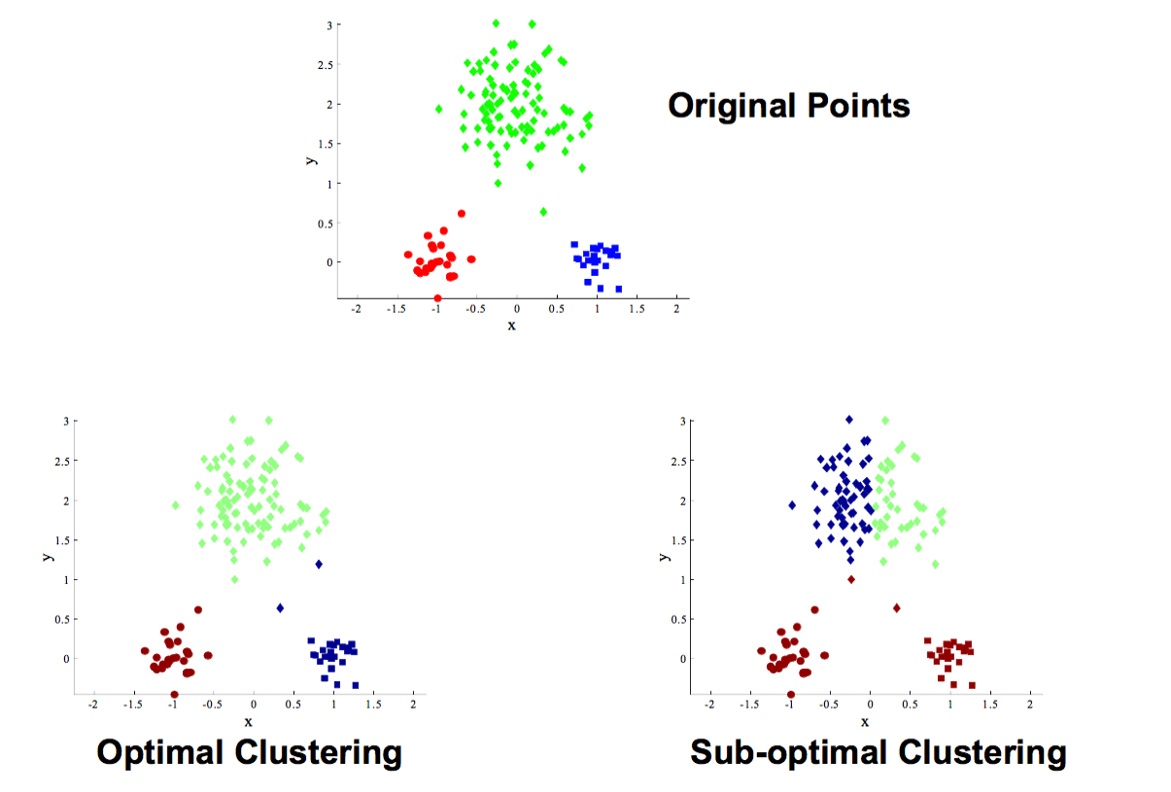
Two-different K-means Clustering

Slide 14
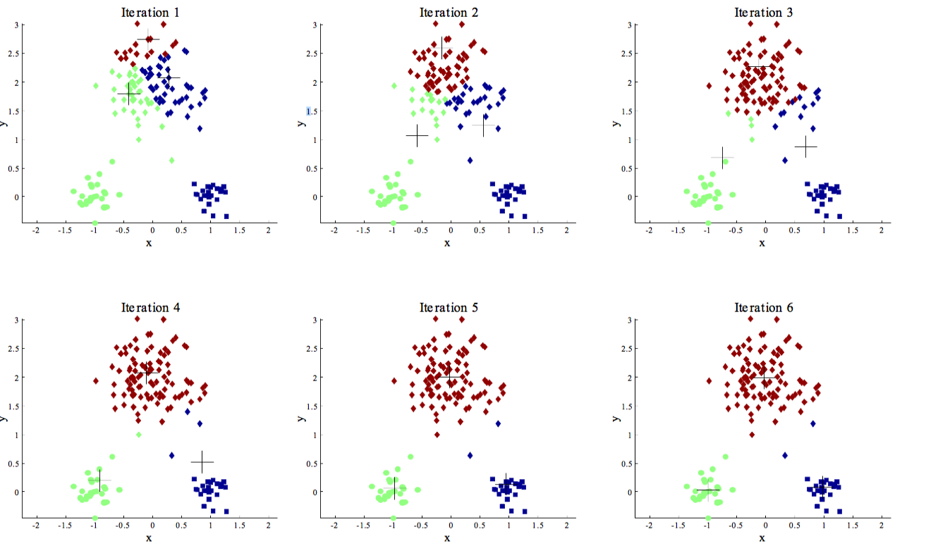
K-means: Example of Optimal Clustering

Slide 15
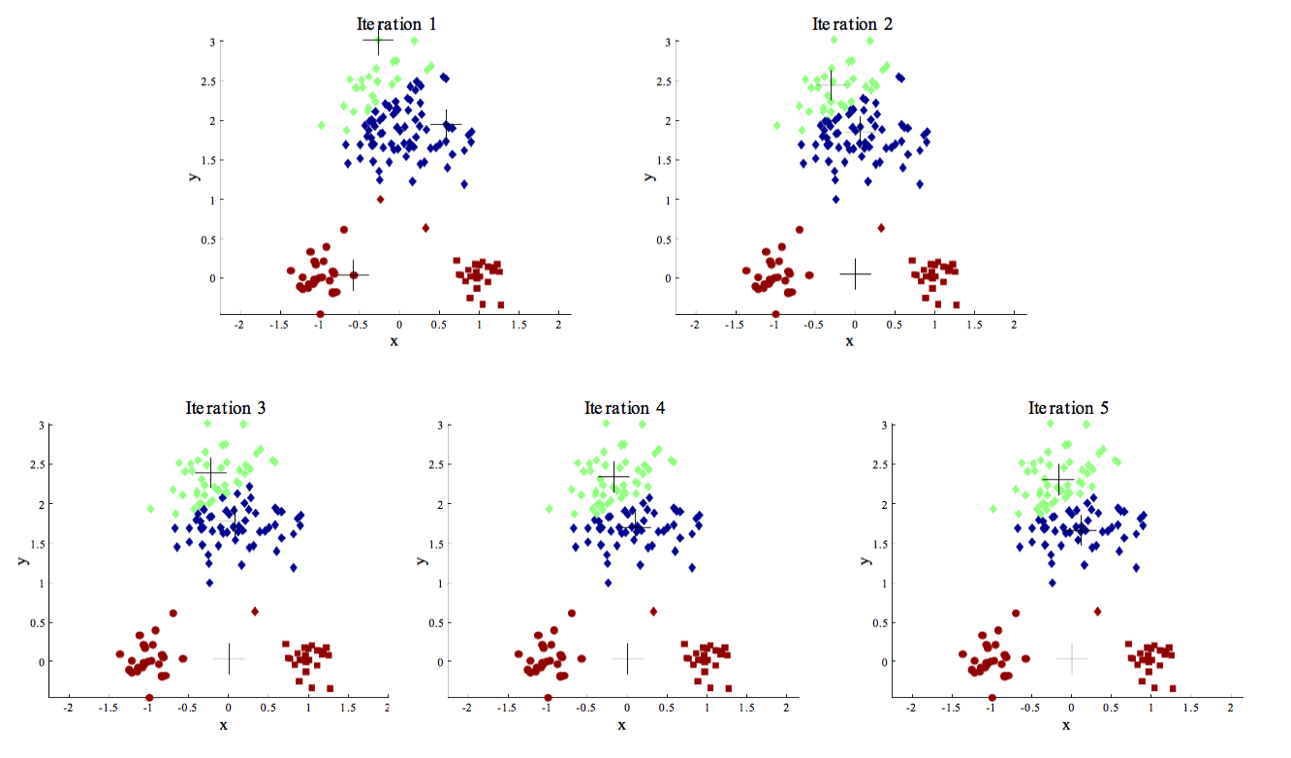
K-means: Example of Sub-optimal Clustering

Slide 16
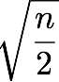
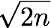
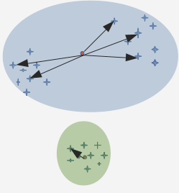
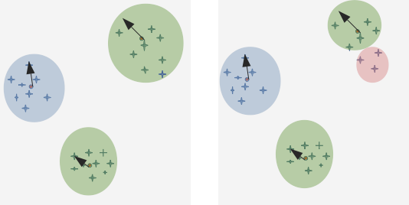
K-means
How to define the number of clusters K
Simple method: Set the number of clusters to about for a data set of n points. In expectation, each cluster has points.
Elbow method:
Try different k, looking at the change in the average distance to centroid, as k increases
K=2
K=3
K=4

Slide 17
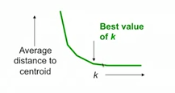
K-means
How to define the number of clusters K
Elbow method:
Try different k, looking at the change in the average distance to centroid, as k increases

Slide 18
K-means
How to pick the initial K points
Approach 1: Sampling
Cluster a sample of data using hierarchical clustering to obtain K clusters
Approach 2: Pick “dispersed” set of points
Pick first point at random
Pick the next point to be the one whose minimum distance from the selected points is as large as possible
Notes:
Avoid outliers, avoid picking points on the same cluster.

Slide 19
Disadvantages of K-means
Sensitive to initialization
K-means can only be applied when the mean is defined
Unable to deal with nominal data type.
Use k-modes method
Need to specify k
Sensitive to noises, and outlier data.
Scale to large dataset?
Use sampling
Use Micro-clusters
Use additional data structure (such as spatial hierarchical data index) to save costs when computing means

Slide 20
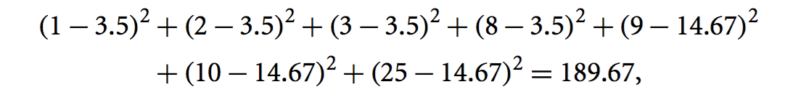
K-medoids: Motivation
K-means algorithm is sensitive to outliers
Example:
Points on 1-D {1, 2, 3, 8, 9, 10} and 25
Good clustering: {1, 2, 3} and {8, 9, 10} where 25 is the outlier
K-means with 2 clusters
Clusters {1, 2, 3} and {8, 9, 10, 25}, within cluster variation is
Clusters {1,2, 3, 8} and {9, 10, 25}, within cluster variation is
K-mean consider the second case better than the first case (due to the outlier point 25)

Slide 21
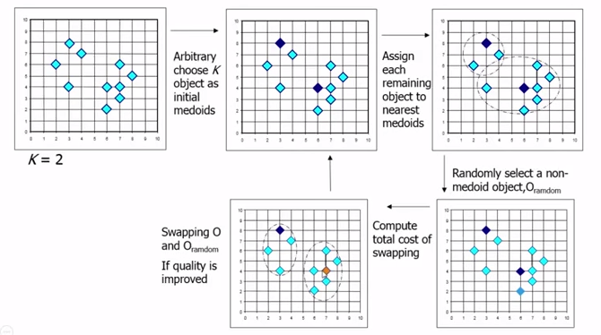
K-medoids
Instead of using the mean as a centroid, K-medoids use a representative point (a point in the data set) as the center for a cluster.
Notes:
The difference between k-means and k-medoids is that centroids of k-means are virtual, K-medoids has representative points.

Slide 22
K-medoids: PAM method
PAM (Partitioning Around Medoid: Kaufmann & Roseeuw 1987)
Starts from an initial set of medoids
Iteratively replaces one of the medoids by one of the non-medoids if it reduces the absolute error of the the resulting clustering.
The absolute-error criterion where o_{i} is the representative point of C_{i}.
Complexity of each iteration of PAM is O(k(n-k)²)
PAM works effectively for small data sets but does not scale well for large data sets.

Slide 23
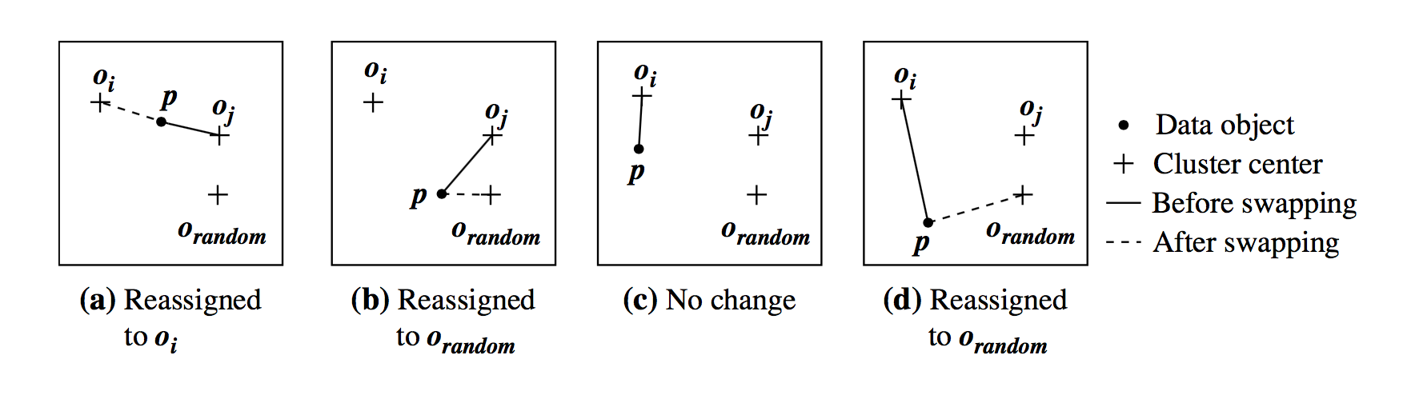
K-means: Swapping centroids
o_{random} can be used to replace o_{j} as one of K centroids?
For each non-centroid point p, p can be reassigned to the new cluster or no change.
Recalculate the cost (absolute error cost).
If the absolute error cost when o_{random} as one of the centroids is smaller the error cost for o_{j} , replace o_{j} by o_{random}.

Slide 24
K-medoids
How to scale K-medoid
CLARA (Clustering Large Applications)
Sample data set, select best K-medoids among the selected sample (using PAM)
Complexity of computing the medoids on a random sample is O(ks²+k(n-k))
Build clustering from multiple samples, then select the best clustering.
CLARANS (Clustering Large Applications based on RANdomized Search)
Randomly select k pints as the current medoids.
Randomly select a current medoid x and an object y that is not one of the current medoids.
[Conduct l times] Can replace x by y improve the absolute-error criterion? If yes, perform replacements.
CLARANS repeats the randomized process m times, and return the best local optimal as the final result.

Slide 25
Outline
Cluster Analysis
Partition Methods
Hierarchical Methods
Density-based Methods
Evaluation of Clustering

Slide 26
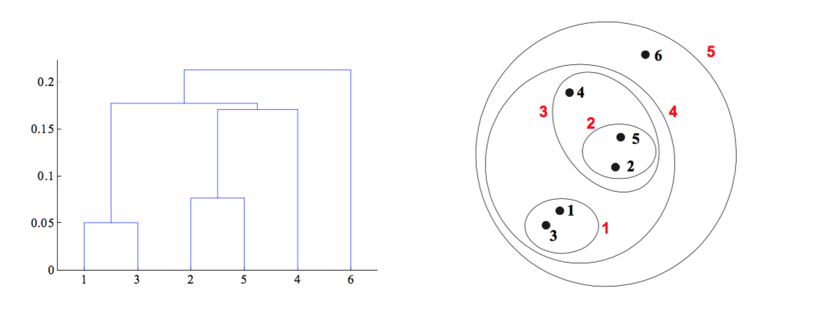
Hierarchical Clustering
Produces a set of nested clusters organized as a hierarchical tree
Can be visualized as a dendrogram
A tree-like diagram that records the sequence of merges and splits

Slide 27
Strength of Hierarchical Clustering
Do not have to assume any particular number of clusters
Any desired number of clusters can be obtained by cutting the dendrogram at the proper level.
They may correspond to meaningful taxonomies
Example in biological sciences (e.g. animal kingdom, phylogeny reconstruction)

Slide 28
Hierarchical Clustering
Two main types of hierarchical clustering
Agglomerative
Start with the points as individual clusters
At each step, merge the closest pair of clusters until only one cluster (or k cluster) left.
Divisive
Start with one, all-inclusive cluster
At each step, split a cluster until each cluster contains a point (or there are k clusters)
Traditional hierarchical algorithms use a similarity or distance matrix
Merge of split one cluster at a time.

Slide 29
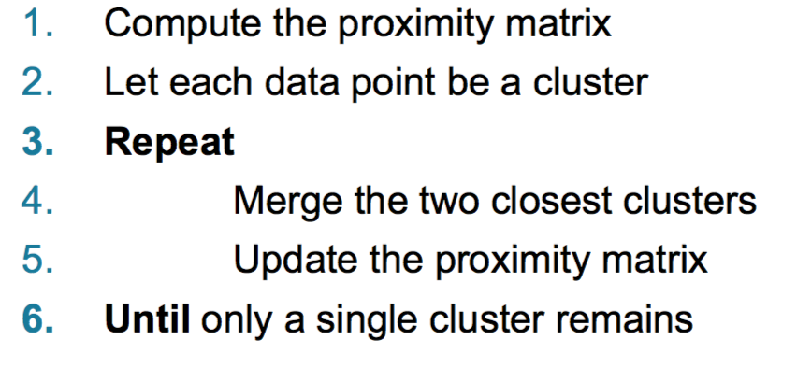
Agglomerative Clustering Algorithm
More popular hierarchical clustering technique
Basic algorithm is straightforward
Key operation is the computation of the proximity of two clusters
Different approaches to defining the distance between clusters lead to different algorithms

Slide 30
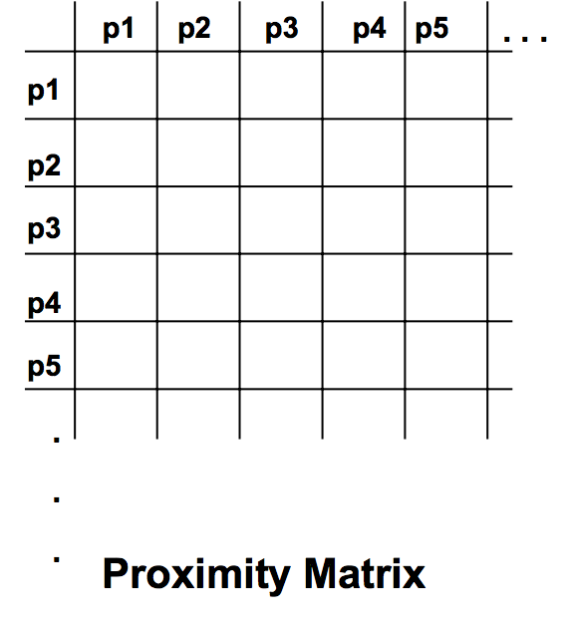
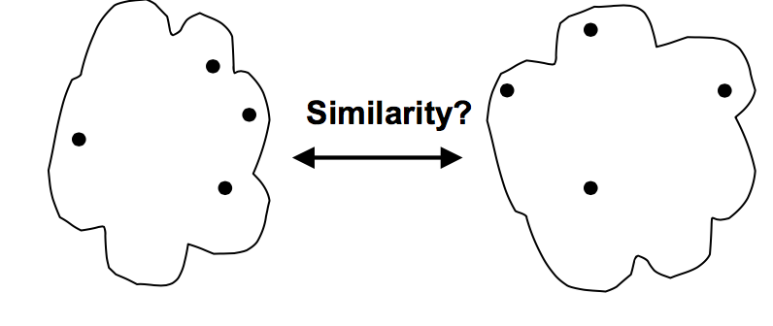
How to define inter-cluster similarity
Min
Max
Group Average
Distance between Centroids

Slide 31
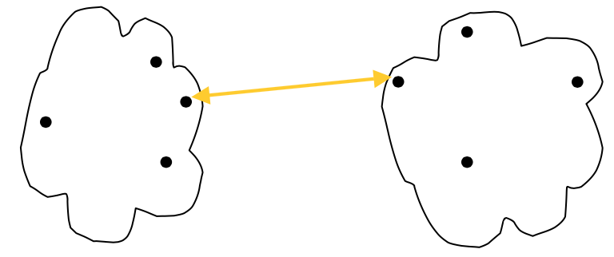
Cluster Similarity: Min or Single Link
Similarity of two clusters is based on the two most similar (closest) points in the different clusters
Determined by one pair of points, i.e., by one link in the proximity graph.
Sensitive to noise, or outliers.

Slide 32
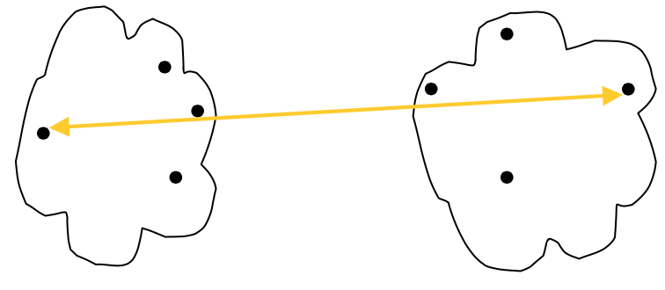
Cluster Similarity: Max or Complete Linkage
Similarity of two clusters is based on the two least similar (most distant) points in the different clusters
Minimize the increase in diameter of the clusters.
Tends to break large clusters

Slide 33
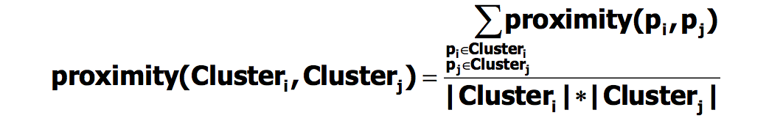
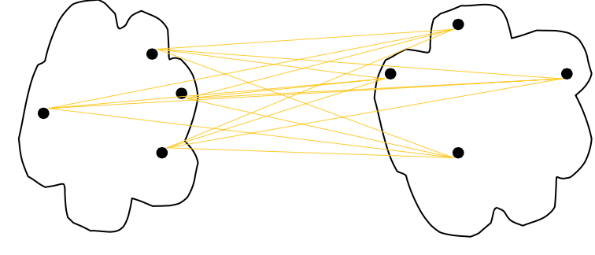
Cluster Similarity: Group Average
Proximity of two clusters is the average of pairwise proximity between points in the two clusters.

Slide 34
Cluster Similarity: Group Average
Compromise between Single and Complete Link
Strengths – Less susceptible to noise and outliers
Limitations – Biased towards globular clusters

Slide 35
Agglomerative Clustering: Time and Space Requirements
O(N²) space since it uses the proximity matrix. – N is the number of points.
O(N³) time in many cases
There are N steps and at each step the size, N², proximity matrix must be updated and searched
Complexity can be reduced to O(N² log(N) ) time for some approaches

Slide 36
Agglomerative Clustering: Problems and Limitations
Once a decision is made to combine two clusters, it cannot be undone
No objective function is directly minimized
Different schemes have problems with one or more of the following:
Sensitivity to noise and outliers
Difficulty handling different sized clusters and convex shapes
Breaking large clusters

Slide 37
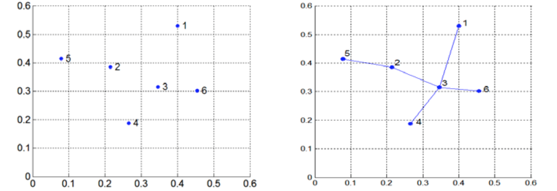
Divisive Hierarchical Clustering: MST
Build MST (Minimum Spanning Tree)
Start with a tree that consists of any point
In successive steps, look for the closest pair of points (p, q) such that one point (p) is in the current tree but the other (q) is not
Add q to the tree and put an edge between p and q

Slide 38
Divisive Hierarchical Clustering: MST
Use MST for constructing hierarchy of clusters
Compute a minimum spanning tree for the proximity graph
Repeat
Create a new cluster by breaking the link corresponding to the largest distance (smallest similarity)
Until only one cluster remains
This approach is the divisive version of the ‘single link’ agglomerative technique that we will see shortly.
Indeed, the hierarchical clustering produced by MST is the same as that produced by single link.

Slide 39
Outline
Cluster Analysis
Partition Methods
Hierarchical Methods
Density-based Methods
Evaluation of Clustering

Slide 40
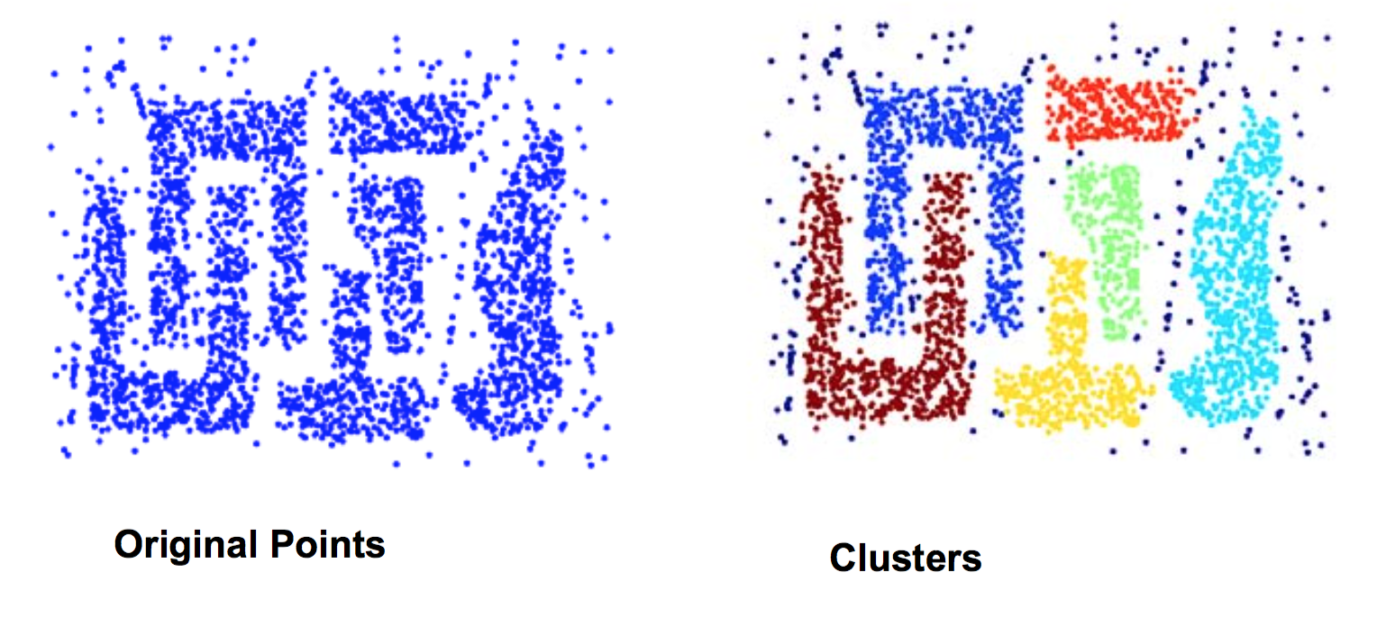
DBScan
DBScan (M. Ester, H.-P. Kriegel, J.Sander and X. Xu, KDD’96)
Density-based Spatial Clustering of Applications with noises
Discover clusters with arbitrary shapes
In contrast to K-means, which can only discover sphere-shape shapes.
Resistant to Noise
Notes:
Impact award in KDD’2014

Slide 41
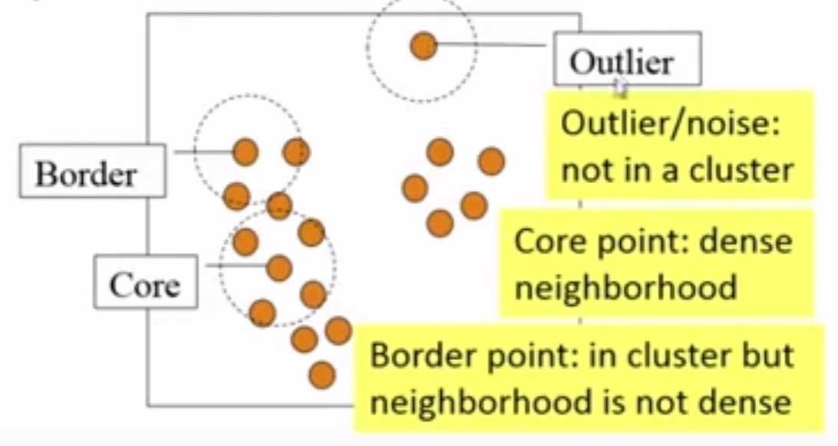
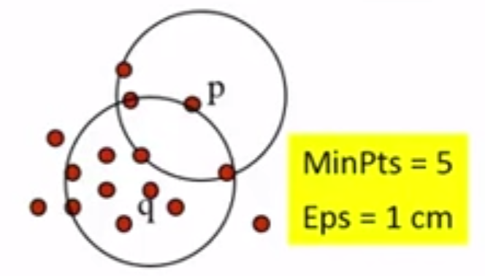
DBSCAN
A density-based notion of cluster
A cluster is defined as a maximal set of density-connected points
Two parameters
Eps: Maximum radius of the neighborhood
MinPts: Minimum number of points in the Eps-neighborhood of a point
The Eps-neighborhood of q:

Slide 42
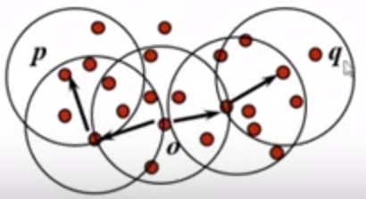
DPSCAN: Density-Reachable and Density-Connected
Directly density-reachable:
p is directly density-reachable from q w.r.t. Eps, MinPts if
p belongs to
Core-point condition:
Density-reachable
p is density-reachable from q w.r.t Eps, MinPts, if there is a chain of points p₁, p₂, …, p_{n} where p₁=p, p_{n}=q and p_{i+1} is directly density-reachable from p_{i}.
Density-connected
p is density-connected to q w.r.t Eps, MinPts if there is a point o that both p and q are density-reachable from w.r.t Eps, and MinPts

Slide 43
DBSCAN Algorithm
Algorithm: DBScan(D, Eps, MinPts)
All points are marked as unvisited
Select a random unvisited point p, mark it as visited
If p is core point, a cluster is formed by retrieving all the density-reachable points from p (w.r.t Eps, MinPts).
If epsilon-neighbor of p doesn’t contain MinPts points, mark p as noise.
Continue the previous process until all the points are processed.
Computational complexity:
If spatial index is used, the computational complexity of DBScan is O(nlogn)
Otherwise, it is O(n²).

Slide 44
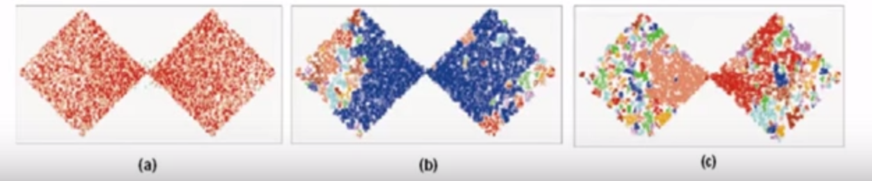
DBSCAN is sensitive the the Setting of Parameters
DBSCAN is sensitive to parameter settings
MinPts=4; a) Eps=5; b) Eps=3.6; c) Eps=3

Slide 45
OPTICS
OPTICS (Ankerst, Breunig, Kriegel, and Sander, SIGMOD’99)
OPTICS (Ordering Points to Identify Clustering Structure)
Improve DBSCAN, which is sensitive to parameter setting
An extension: finding cluster structure
Observation: Given a MinPts, density-based clusters w.r.t. a higher density are completely contained in clusters w.r.t lower density.
That is, given a MinPts, Eps1 < Eps2, a cluster C w.r.t (Eps1, MinPts) must be a subset of a cluster C’ w.r.t (Eps2, MinPts)

Slide 46
OPTICS
Given Eps, MinPts, OPTICS stores two pieces of information per point p:
Core-distance: the minimum Eps’ to make the point p a core object. Core-distance is undefined, if p is not a core point w.r.t (Eps, MinPts)
Reachability-distance: the reachability distance to p from q
If q is not core-object w.r.t (Eps, MinPts), undefined
If q is core-object w.r.t (Eps, MinPts) and p is density-reachability from q, max{core-distance(p), dist(p,q)}
The smallest reachability-distance of p is of interest.

Slide 47
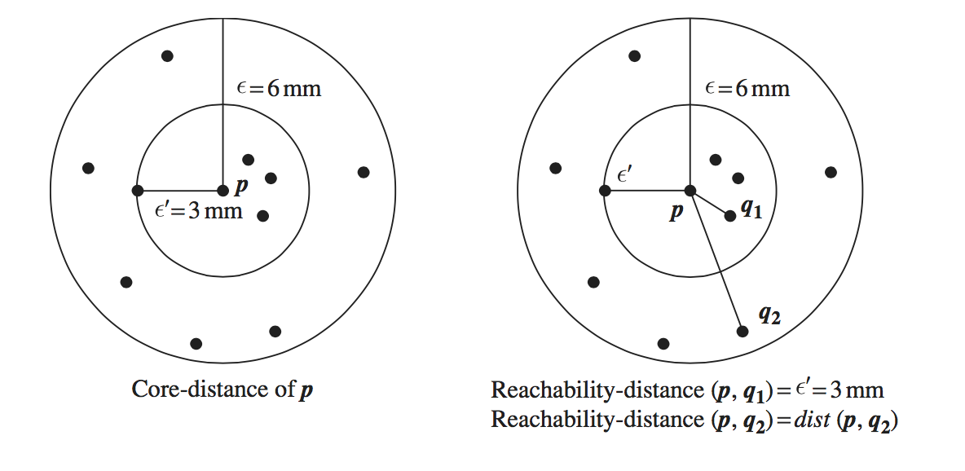
Example of Core-distance and Reachability Distance
Suppose Eps=6mm, MinPts=5

Slide 48
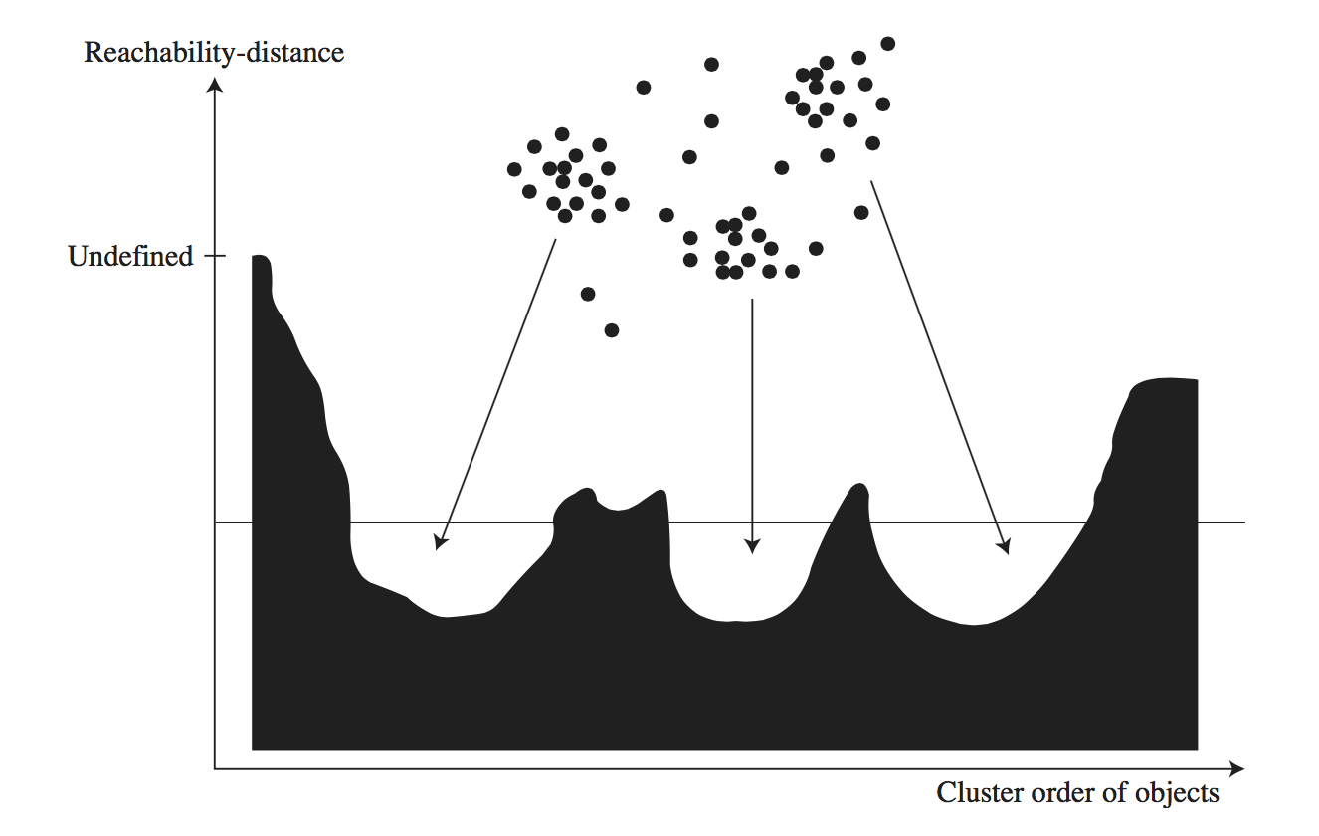
OPTICS
OPTICS outputs a cluster ordering so that
Objects in a denser cluster are listed closer to each other in the cluster ordering.
The cluster ordering contains information equivalent to density-based clustering corresponding to broader range of parameter settings.

Slide 49
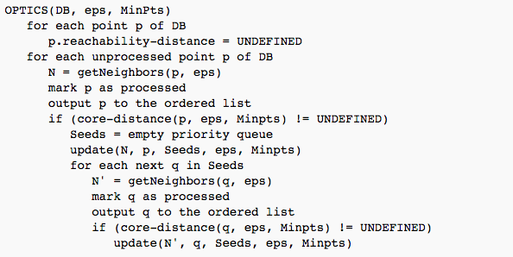
OPTICS Algorithm
(p is core-point
w.r.t (eps, Minpts)
update(N, p, Seeds, eps, Minpts): update reachability distance of points in N to Seeds, which takes into account reachability distance from p .

Slide 50
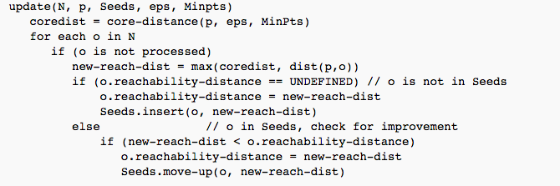
OPTICS Algorithm
The object with the lowest reachability distance are picked first from priority queue.

Slide 51
OPTICS: Computational Complexity
Similar to DBSCAN
O(n²) in general case
O(nlogn) if a spatial index is used.

Slide 52
Outline
Cluster Analysis
Partition Methods
Hierarchical Methods
Density-based Methods
Evaluation of Clustering

Slide 53
Assessing Clustering Tendency
Determine whether a data set has non random structure, which may lead to meaningful clusters.
How to assess the clustering tendency of a dataset?
Main idea: Check whether the data set is generated by a uniform distribution.
Statistical test for spatial randomness using Hopkin Statistics

Slide 54
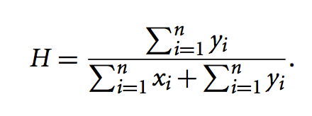
Hypothesis testing with Hopkins Statistics
Calculate Hopkins Statistic
Sample uniformly n artificial points p₁, p₂, …, p_{n} from the data space of data set D. For each point pi, let xi be the distance to the nearest neighbor of pi in D to pi.
Sample uniformly n real points q₁, q₂, …, q_{n} from data set D. For each qi, let y_{i} be the distance to the nearest neighbor of qi in D to qi.
Hopkins Statistics:
If D is uniformly distributed, then sum of y_{i} is smaller than sum of x_{i} in expectation; thus H is smaller than 0.5.

Slide 55
Measuring Cluster Quality
Extrinsic Method
Compare clustering result with a grout truth
Intrinsic Method
Evaluate the goodness of a clustering by considering how well the clusters are separated.

Slide 56
Extrinsic Evaluation Methods
Clustering Quality
Cluster Homogeneity: the more pure the clusters in a clustering, the better the clustering.
Cluster Completeness: if any two objects belong to the same category in the ground truth, they should be assigned to the same cluster.
Rag bag:
A cluster C contains objects from multiple categories from ground truth is called the rag bag.
Wrongly put an object into a pure cluster is penalized more than putting it to rag bag.
Small cluster preservation
Splitting a small category into pieces is more harmful than splitting a large category.

Slide 57
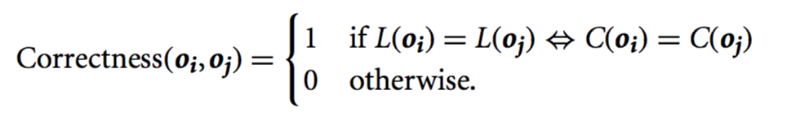
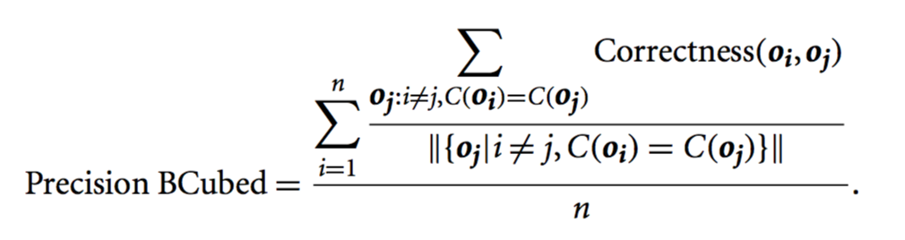
Extrinsic Evaluation Methods
Notations
Let D={o₁, o₂, …, o_{n}} be a set of objects. C be a clustering on D
L(o_{i}) is the category of oi in the ground truth
C(o_{i}) is the cluster of o_{i} in C.
Correctness: the correctness of two objects o_{i} and o_{j} in D
BCubed precision

Slide 58
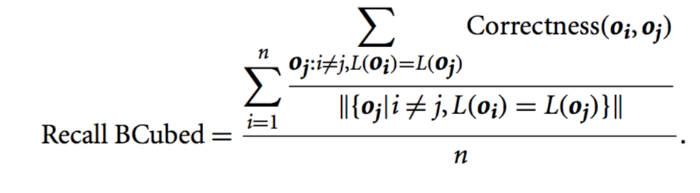
Extrinsic Evaluation Methods
BCubed recall

Slide 59
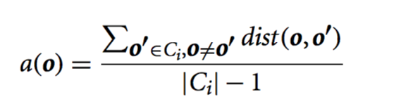
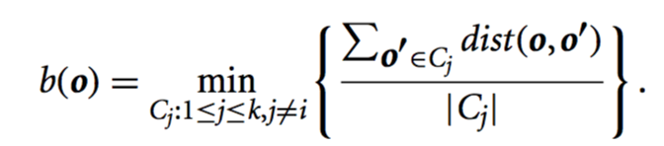
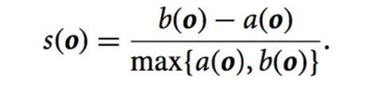
Intrinsic Evaluation Methods
D={o₁, o₂, …, o_{n}} be a set of objects. C ={C₁, C₂, .., C_{k}} be a clustering on D
Silhouette coefficient
The average distance between o in C_{i} to all the other objects in C_{i}
The minimum distance between o in C_{i} to all C_{j} (j != i)
The silhouette coefficient is
(the smaller, the more compact the cluster)
(the larger, the more o is separated from other)
(s(o) in [-1,1])
(s(o) ~1 if the cluster containing o is compact and far away from other clusters)

Slide 60
Summary
Cluster Analysis
Partition Methods
Hierarchical Methods
Density-based Methods
Evaluation of Clustering

